Slide 1
Gulp
Introduction for the .NET Developer
Justin James
@digitaldrummerj | http://digitaldrummerj.me
#MusicCityCode

Slide 2


Slide 3
Why Use Gulp?
Automate Repetitive Tasks
Improve Efficiency
Frees up Your Time

Slide 4

What Can You Do?
Compile .NET Project
Increment Versions
Lint Javascript
Concat and Minify
Sass Compilation
Inject Files References into HTML Code
Refresh Browser on File Changes

Slide 5
What is in it for me?
Repeatable
Deliver Faster
Improve Quality

Slide 6
Gulp Overview
Gulpfile.js
Code over configuration
Stream based
1100+ plugins
Notes:
Resources:
Cheatsheet - https://github.com/osscafe/gulp-cheatsheet
Learning Gulp http://hmphry.com/gulp/

Slide 7
Gulp Task in a Nutshell
File System
Dest
Read Files
jshint
uglify
concat
Write Files

Slide 8
Gulp Streams In Action
Start with a source set of files
Process or examine the files
Send output to a destination

Slide 9
Processing against the files is done in memory making Gulp very fast.

Slide 10
Gulp APIs

Slide 11
6 APIs
task
src
dest
watch
series
parallel

Slide 12
gulp.task (name, fn)
gulp.task("default", function (done) {
console.log("Hello Music City Code");
done();
});
optional callback called done

Slide 13
2. gulp.src ( glob [, options] )
gulp.task("lint", function () {
return gulp.src(['./app/**/*.js',
'!./node_modules/**/*'])
.pipe(plugins.eslint())
});
Takes a set of files
Pipes them to a gulp task
To exclude paths, add a ! In front of the path

Slide 14
3. gulp.dest ( folder [, options] )
gulp.task("bump:patch", function () {
return gulp.src('./**/AssemblyInfo.cs')
.pipe(plugins.assemblyInfo({ version: newVer }))
.pipe(gulp.dest('./'));
});
Write files to destination
Optionally specify options to apply to the output folder

Slide 15
gulp.watch ( glob [, options])
var styleWatcher = gulp.watch(styles,
{ ignorePermissionErrors: true });
styleWatcher.on('add', function (file) { });
Monitor paths/files for changes
Events: add, addDir, change, unlink, unlinkDir, ready, raw, error
Notes:
.on(event, callback): Listen for an FS event.
Available events: add, addDir, change, unlink, unlinkDir, ready, raw, error.
Additionally all is available which gets emitted with the underlying event name and path for every event other than ready, raw, and error.
see: https://github.com/paulmillr/chokidar

Slide 16

gulp.series (name, name, fn)
gulp.task('inject'), gulp.series(
injectJavaScript,
injectCss
));
true way to do dependencies
Note: returns function, so can’t be used within a function

Slide 17
gulp.parallel (name, name, fn)
gulp.task('inject'), gulp.parallel (
injectJavaScript,
injectCss
));
Run just like old dependencies did. all at once.
Note: returns function, so can’t be used within a function
Notes:
Need Code!!

Slide 18
Combine series and parallel
gulp.task('inject'), gulp.series (
RunFirst,
gulp.parallel (injectJavaScript, injectCss)
));
Notes:
Need Code!!

Slide 19
Installing Gulp 4.0

Slide 20
Getting Node.js
Manual Install
Automated Install
Run installer from
http://nodejs.org
Install Chocolatey
https://chocolatey.org/
choco install nodejs -y

Slide 21
npm install -g gulp-cli
npm init
npm install –save-dev git+https://git@github.com/gulpjs/gulp.git#4.0

Slide 22
package.json
"devDependencies": {
"gulp" : "git+https://git@github.com/gulpjs/gulp.git#4.0"
}
Holds all of the node module dependencies and development dependencies.

Slide 23
require is the way that you pull in node modules.
'use strict';
var gulp = require('gulp');

Slide 24
Running Tasks in Visual Studio

Slide 25
Tasks in Visual Studio
Runs gulp tasks from Visual Studio
Use existing tasks
Add actions via custom bindings

Slide 26
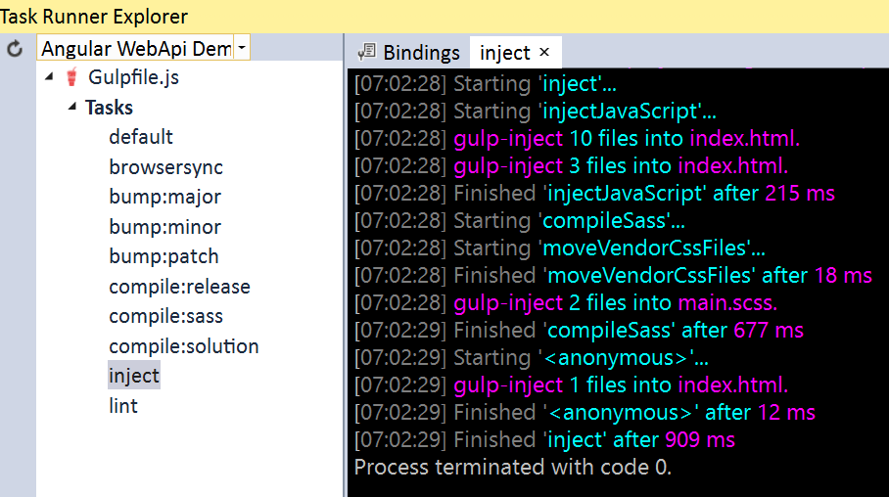
Task Runner Explorer

Slide 27
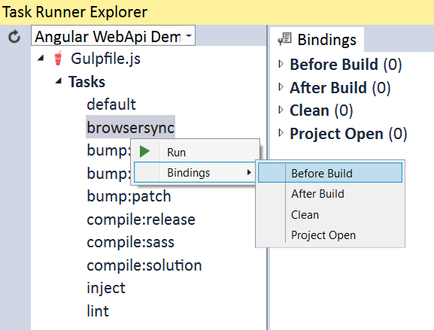
Add Custom Bindings

Slide 28
Demo

Slide 29
Summary

Slide 30
What We’ve Learned
Why you should use Gulp
How to use Gulp
How to create tasks

Slide 31
6 Gulp APIs
task
src
dest
watch
series
parallel

Slide 32
Resources
http://gulpjs.com/plugins/
http://gulpjs.com
Gulp Plugins
Gulp Main Web Site

Slide 33
Thank you
http://digitaldrummerj.me/speaking/#gulp
@digitaldrummerj

